Slide 1


Introduction to Machine Learning
DBDA.X408.(33)
Instructor:
Bill Chen
UCSC Silicon Valley Extension
E: xch375@ucsc.edu

Slide 2
Week 4
Feature Engineering.
ML Tooling: Python
PyTorch
TensorFlow
Data understanding using plots

Slide 3
Feature Reduction
A linear or non-linear transform on the original feature space.
Unsupervised methods
Principal Component Analysis (PCA)
Independent Component Analysis (ICA)
Autoencoder
Supervised methods
Linear Discriminant Analysis (LDA)
Notes:
This section will focus on PCA.

Slide 4
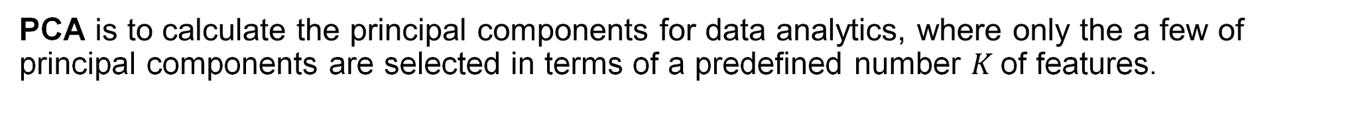
PCA (Principal component analysis)
It is commonly used for dimensionality reduction by projecting each data point onto only the first few principal components to obtain lower-dimensional data while preserving as much of the data's variation as possible.
The first principal component can equivalently be defined as a direction that maximizes the variance of the projected data.
The i^{th} principal component can be taken as a direction orthogonal to the i – 1 principal components, which maximizes the variance of the projected data.
Notes:
These principal components would be orthogonal. In other words, they would be independent.
It performs a linear mapping of the data to a lower-dimensional space in such a way that projection distances in the low-dimensional representation are maximized.

Slide 5
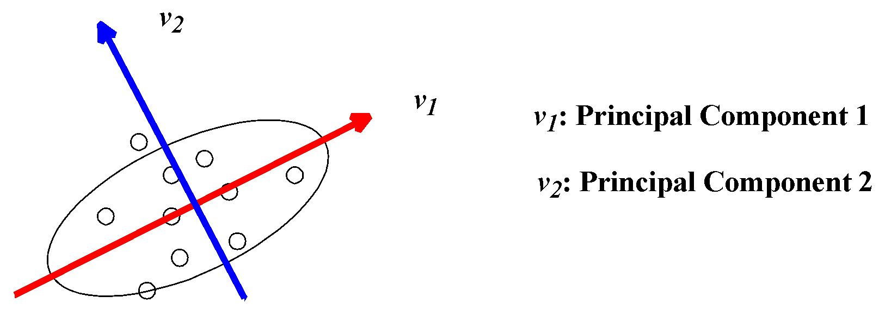
PCA (Principal component analysis)
The goal of PCA is to reduce the dimensionality of the data while preserving the variation present in the dataset as much as possible.
The axes have been rotated to new principal components such that:
Principal component 1 has the highest variance.
Principal component 2 has the next highest variance, and so on.
Notes:
The circles in this figure are samples in the data.
If we project these samples along with v1, we can observe the sum of projection distances are larger than that projected along with v2.

Slide 6
PCA (Principal component analysis)
Principal Components (PCs): orthogonal vectors that are ordered by the fraction of the total information (variation) in the corresponding directions.
PCs can be found as the “best” eigenvectors of the covariance matrix of the data points.
PCs are linear least squares fits to samples, each orthogonal to the previous PCs:
First PC is a minimum distance fit to a vector in the original feature space
Second PC is a minimum distance fit to a vector in the plane perpendicular to the first PC

Slide 7
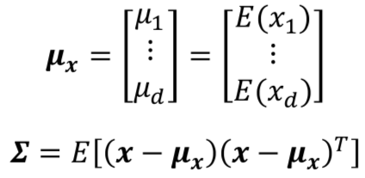
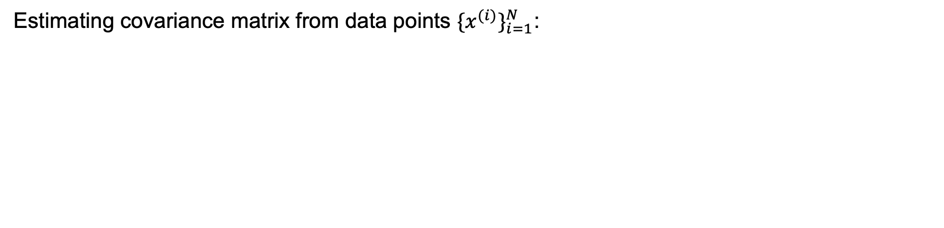
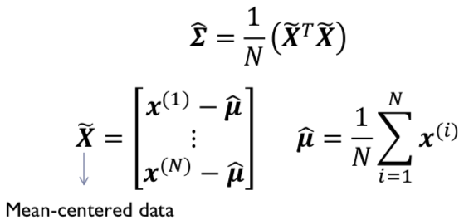
Mathematics for PCA
Covariance Matrix
Notes:
Here are some points of mathematics for PCA.

Slide 8
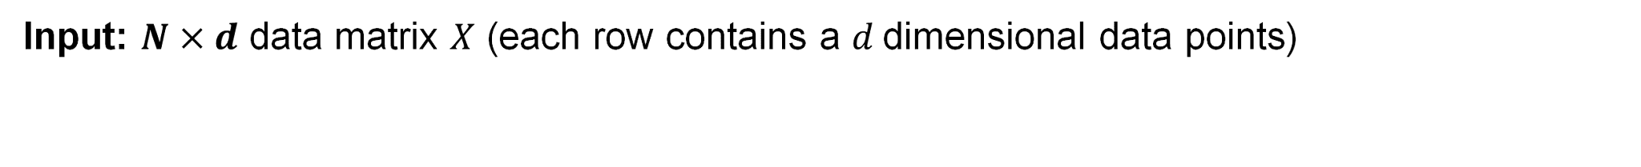
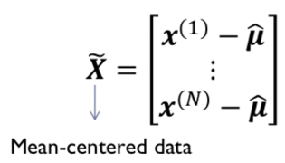
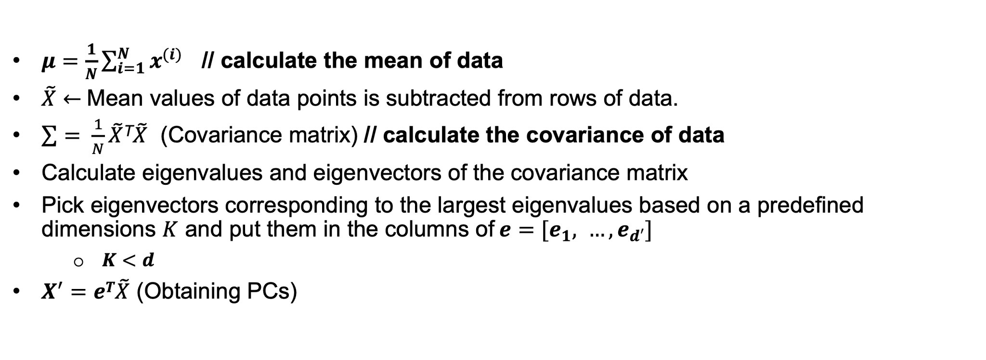
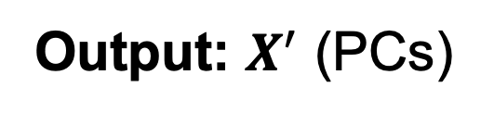
Calculating PCA
Notes:
Here are the detailed steps to obtain PCs.

Slide 9
An Example of PCA application
House Information
# | House Price | Area
1 | 10 | 9
2 | 2 | 3
3 | 1 | 2
4 | 7 | 6.5
5 | 3 | 2.5
Two features of house data
House Price (Million of dollars)
House Area
Notes:
Let us use one example to check how to use PCA to implement feature reduction.
Two features for this data.

Slide 10
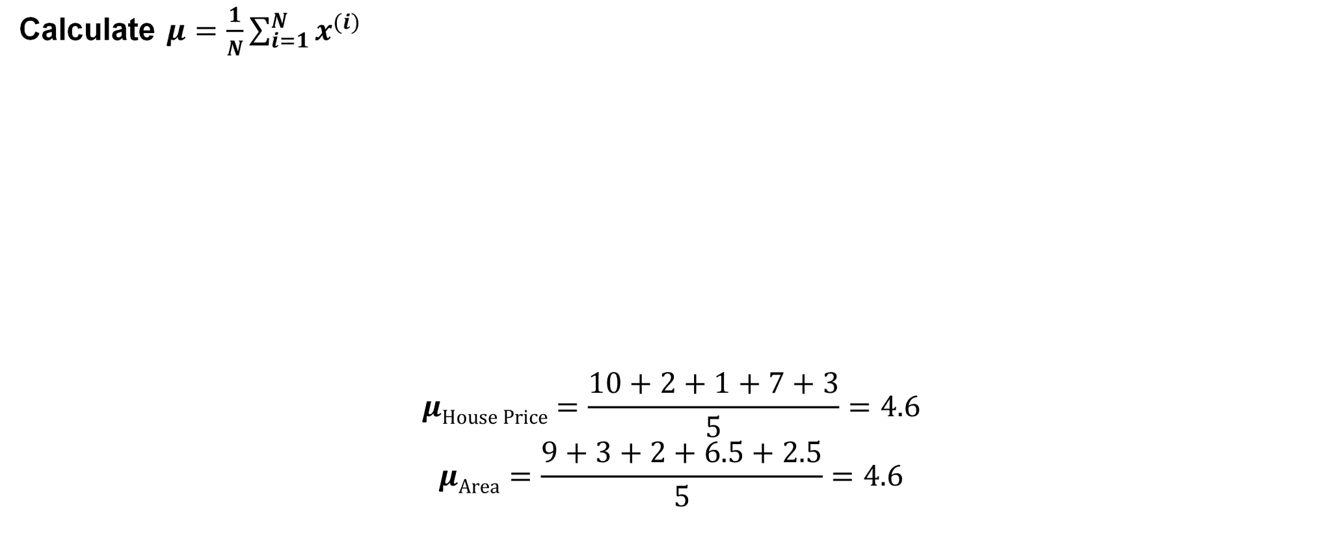
An Example of PCA application
# | House Price | Area
1 | 10 | 9
2 | 2 | 3
3 | 1 | 2
4 | 7 | 6.5
5 | 3 | 2.5
Notes:
We calculate the mean of each features.

Slide 11
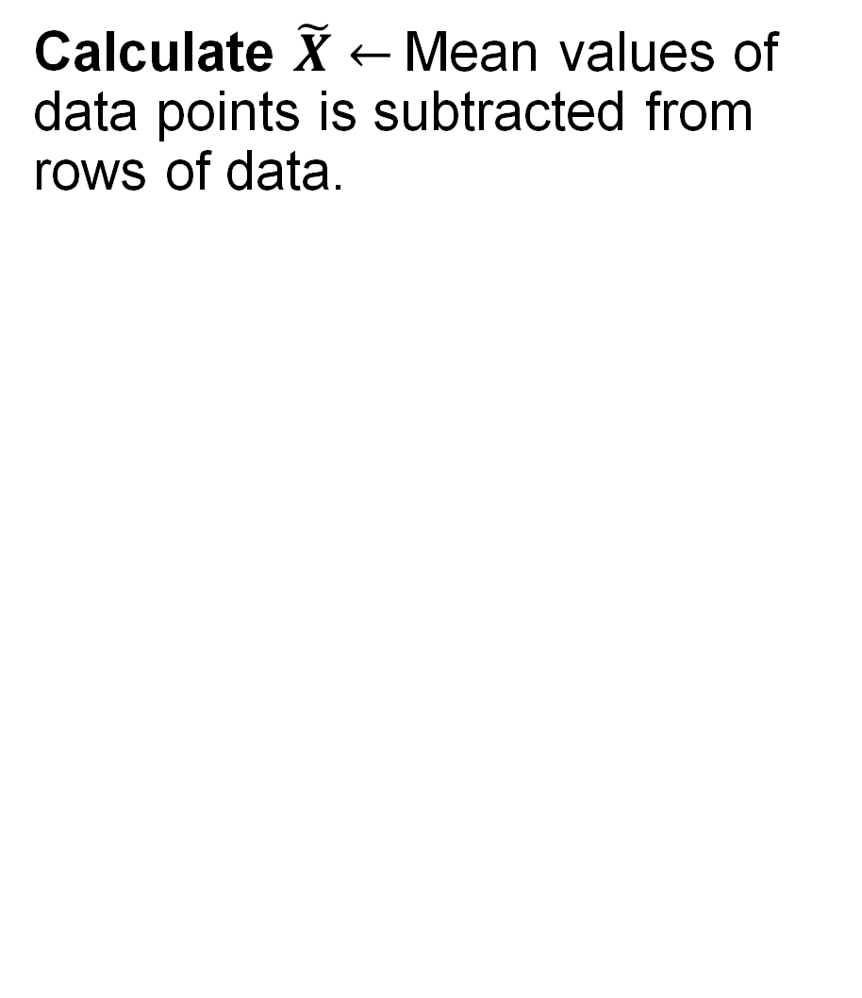
An Example of PCA application
# | House Price | Area
1 | 10 – 4.6 | 9 – 4.6
2 | 2 – 4.6 | 3 – 4.6
3 | 1 – 4.6 | 2 – 4.6
4 | 7 – 4.6 | 6.5 – 4.6
5 | 3 – 4.6 | 2.5 – 4.6
# | House Price | Area
1 | 5.4 | 4.4
2 | -2.6 | -1.6
3 | -3.6 | -2.6
4 | 2.4 | 1.9
5 | -1.6 | -2.1
Notes:
We centralize the features by subtracting the mean.

Slide 12
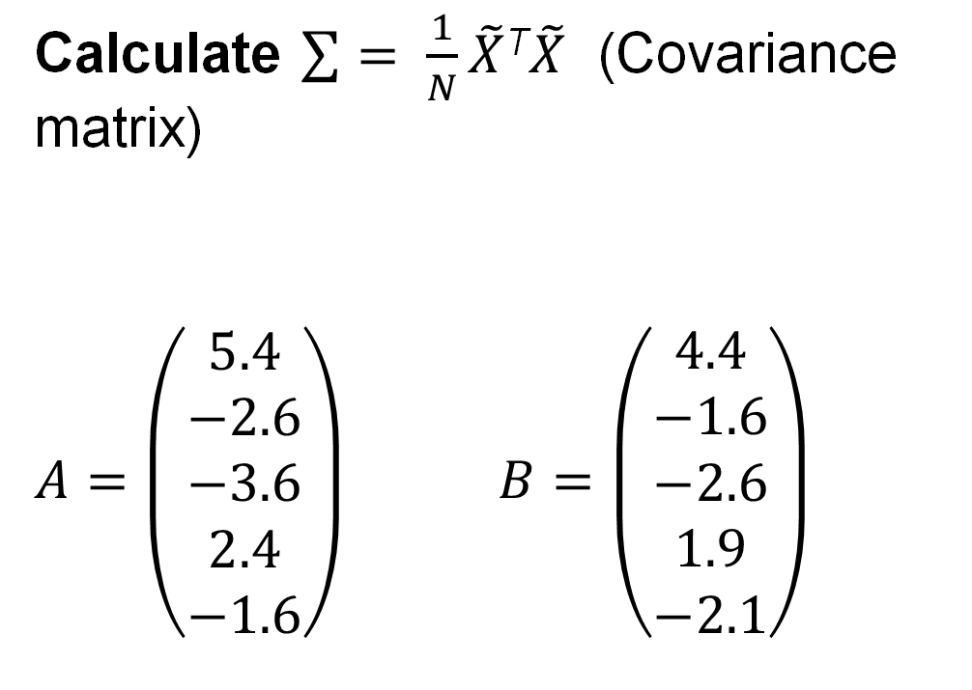
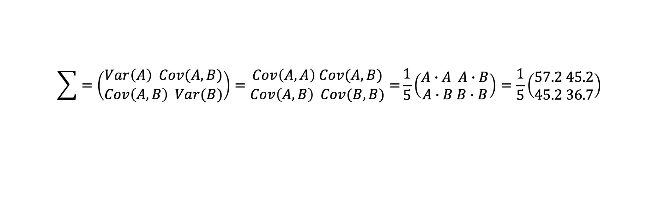
An Example of PCA application
# | House Price | Area
1 | 5.4 | 4.4
2 | -2.6 | -1.6
3 | -3.6 | -2.6
4 | 2.4 | 1.9
5 | -1.6 | -2.1
Notes:
Calculate the covariance.

Slide 13
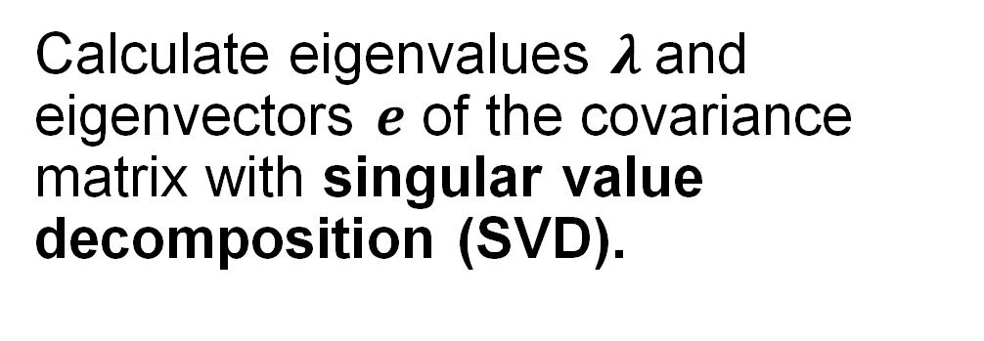

An Example of PCA application
# | House Price | Area
1 | 5.4 | 4.4
2 | -2.6 | -1.6
3 | -3.6 | -2.6
4 | 2.4 | 1.9
5 | -1.6 | -2.1
Notes:
Calculate eigenvalues 𝝀 and eigenvectors 𝒆 of the covariance matrix with SVD on the Covariance matrix.

Slide 14
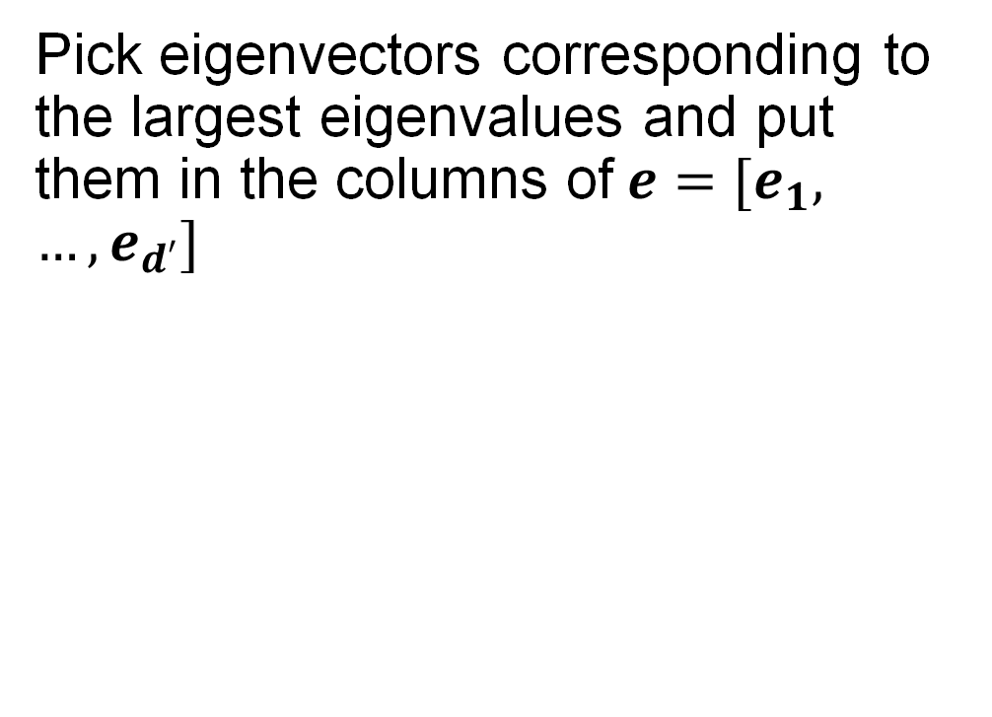
An Example of PCA application
# | House Price | Area
1 | 5.4 | 4.4
2 | -2.6 | -1.6
3 | -3.6 | -2.6
4 | 2.4 | 1.9
5 | -1.6 | -2.1

Slide 15
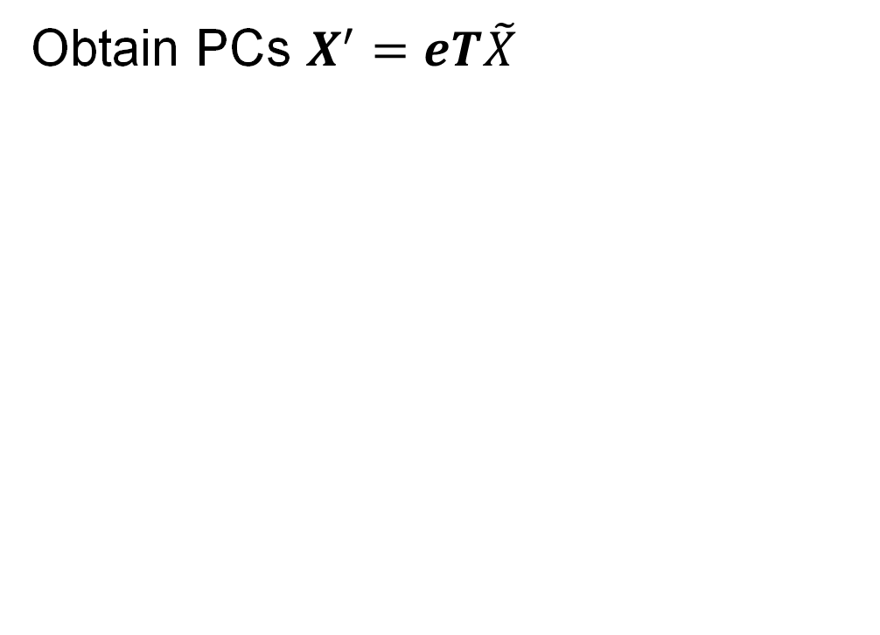


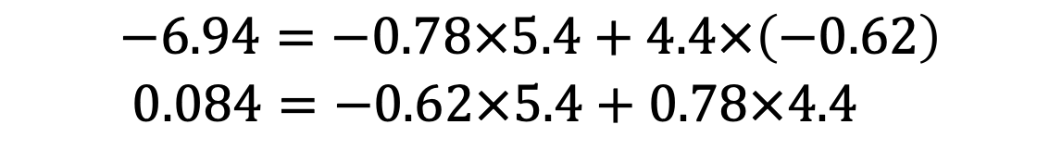
An Example of PCA application
# | PC1 | PC2
1 | -6.94 | 0.084
2 | 3.02 | 0.364
3 | 4.42 | 0.204
4 | -3.05 | -0.006
5 | 2.55 | -0.646

Slide 16
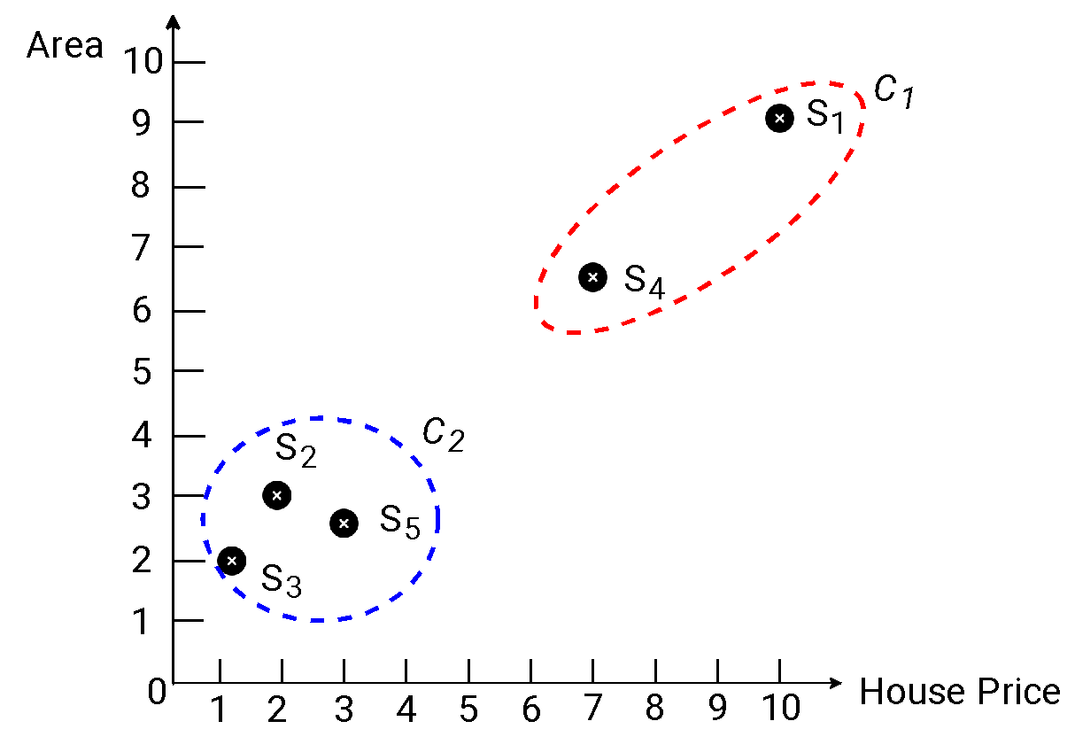
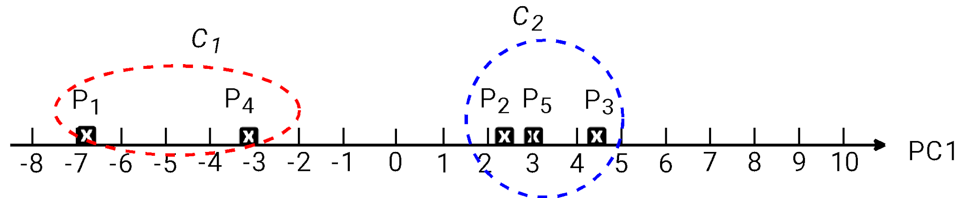
PCA for clustering
Point | House Price | Area
S₁ | 10 | 9
S₂ | 2 | 3
S₃ | 1 | 2
S₄ | 7 | 6.5
S₅ | 3 | 2.5
PCA
Map 2D to 1D
Point | PC1
P₁ | -6.94
P₂ | 3.02
P₃ | 4.42
P₄ | -3.05
P₅ | 2.55
Notes:
If we do clustering on the original space, it is not obvious to group S4 and S1 into one cluster.
If we do clustering with PC1, it is easier to group P1 and P4 into the same cluster if the clustering rules are below.
if Pi < 0, Pi belongs to C1
if Pi > 0, Pi belongs to C2

Slide 17
Unsupervised Learning

Slide 18
Supervised Learning vs Unsupervised Learning
Supervised Learning
Data: (x, y)
Goal: Learn function to map, discover patterns in the data that relate data attributes with a target (class) attribute.
Examples: Classification, Regression, Object detection,
Object tracking, etc.
Unsupervised Learning
Data: x
Goal: Learn the hidden or intrinsic structure of the data
Examples: Clustering, dimensionality reduction,
etc.

Slide 19
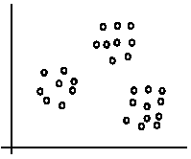
Clustering
Clustering is a technique for finding similarity groups in data, called clusters. i.e.,
It groups data instances that are similar to (near) each other in one cluster and data instances that are very different (far away) from each other into different clusters.
Clustering is often called an unsupervised learning task
No class values
Clustering is often considered synonymous with unsupervised learning.
C₂
C₃
C₁

Slide 20
Applications Based on Clustering
Example 1: groups people of similar sizes together to make “small”, “medium” and “large” T-Shirts.
Tailor-made for each person: too expensive
One-size-fits-all: does not fit all.
Example 2: In marketing, segment customers according to their similarities
To do targeted marketing.
Example 3: Group a collection of text documents according to their content similarities,
To produce a topic hierarchy
In fact, clustering is one of the most utilized data mining techniques.
It has a long history, and used in almost every field, e.g., medicine, psychology, botany, sociology, biology, archeology, marketing, insurance, libraries, etc.

Slide 21
Aspects of Clustering
A clustering algorithm
Partitional clustering
Hierarchical clustering
…
A distance (similarity, or dissimilarity) function
Clustering quality
Inter-clusters distance => maximized
Intra-clusters distance => minimized
The quality of a clustering result depends on the algorithm, the distance function, and the application.

Slide 22
Summary
Clustering (Unsupervised Learning) has a long history and is still active.
There are a huge number of clustering algorithms
More are still coming every year.
Clustering is hard to evaluate, but very useful in practice.
Clustering is highly application dependent and to some extent subjective.

Slide 23
K-means

Slide 24
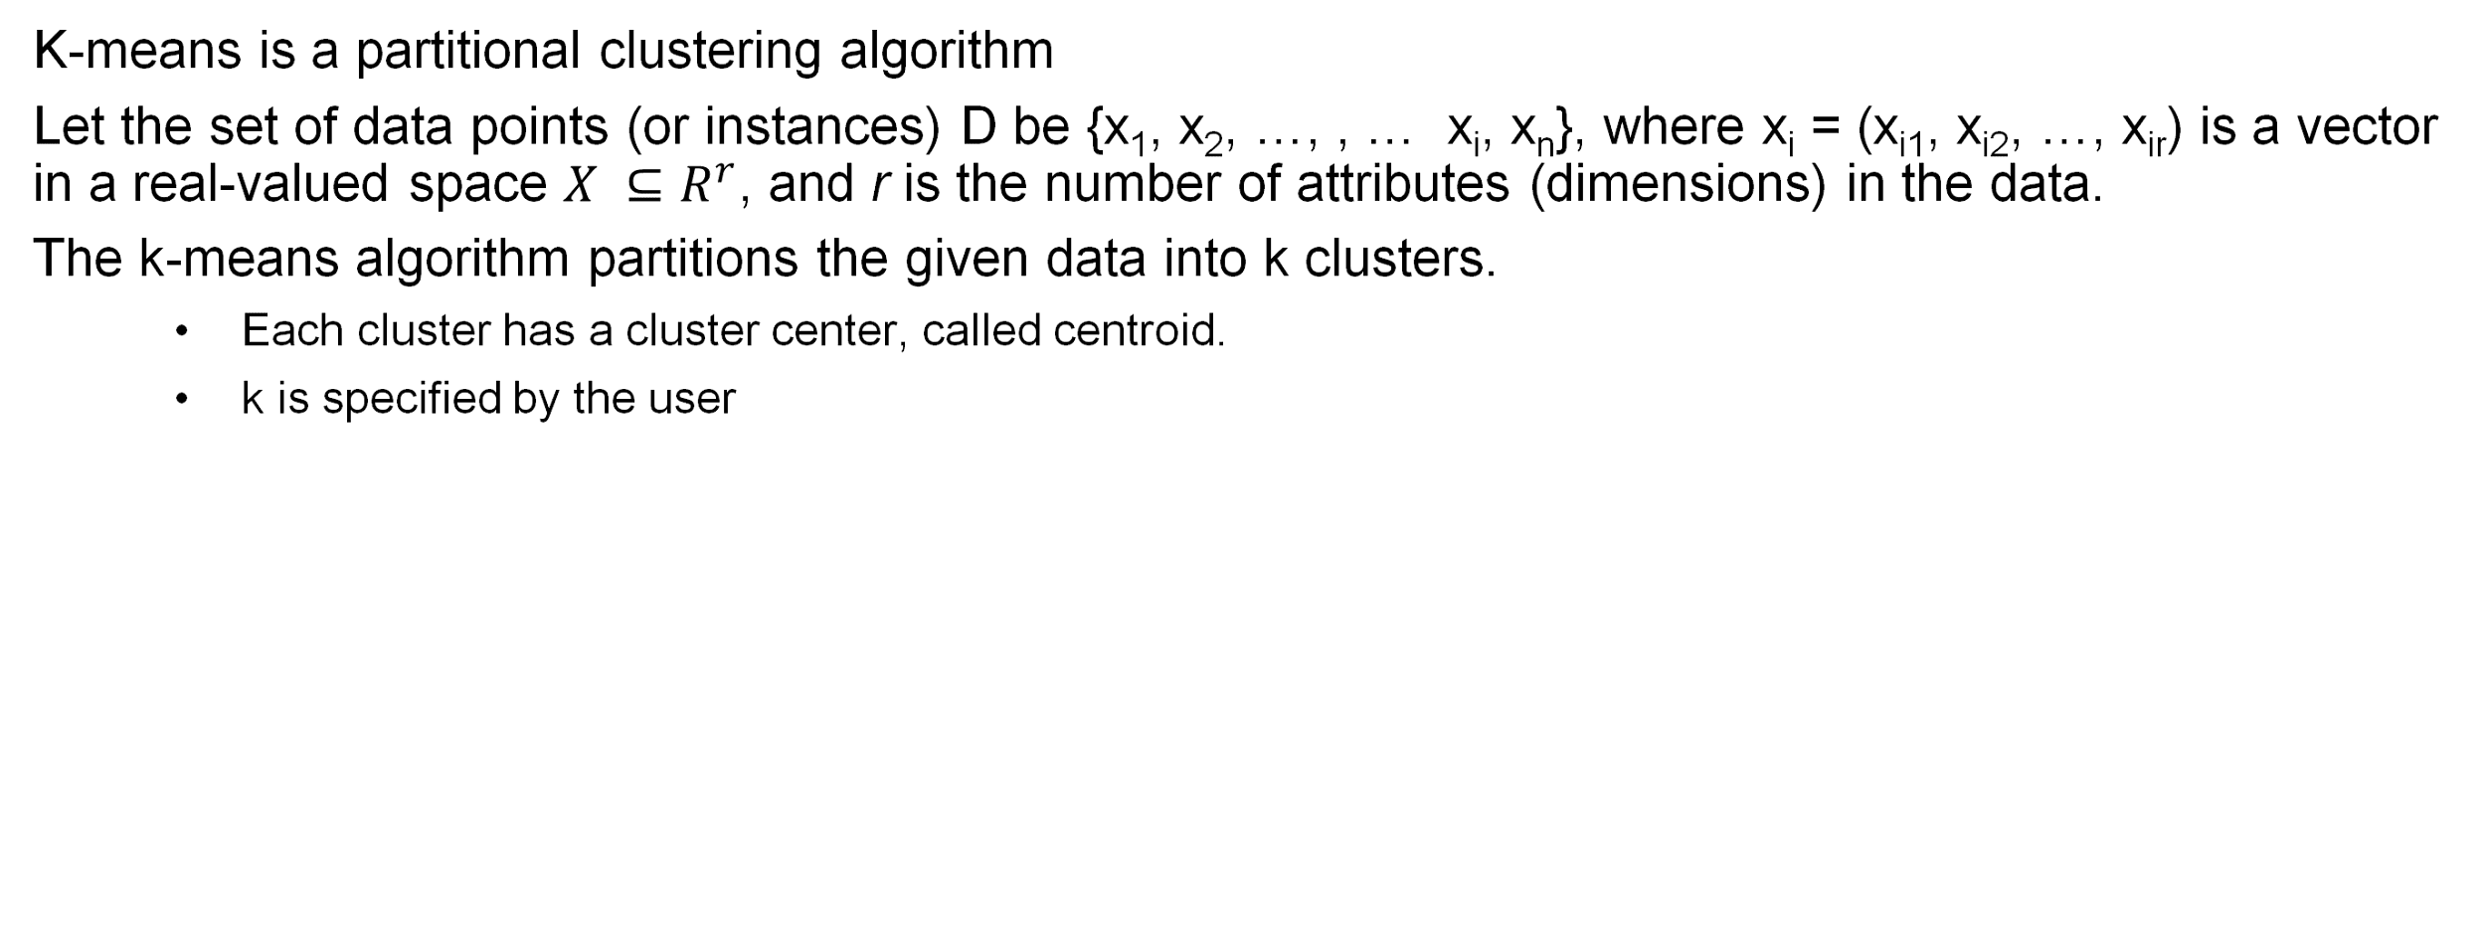
K-means Clustering

Slide 25
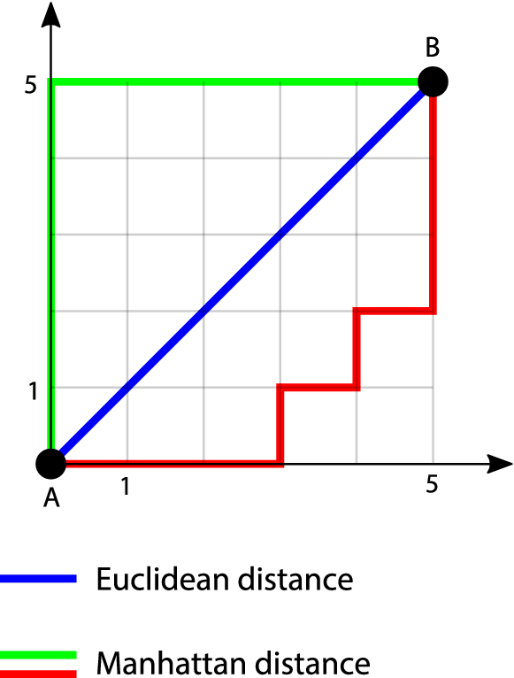
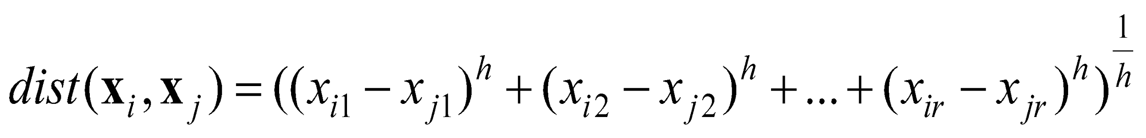
Distance Functions
Key to clustering. “similarity” and “dissimilarity” can also commonly used terms.
There are numerous distance functions for
Different types of data
Different specific applications
Most commonly used functions are
Euclidean distance and
Manhattan (city block) distance
They are special cases of Minkowski distance. h is positive integer

Slide 26
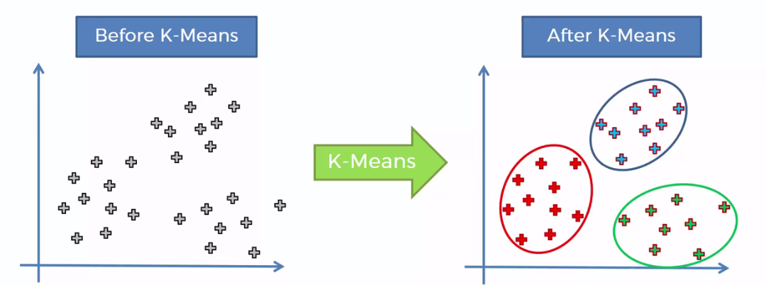
Algorithm
Given k, the k-means algorithm works as follows:
Randomly choose k data points (seeds) to be the initial centroids, cluster centers
Assign each data point to the closest centroid
Re-compute the centroids using the current cluster memberships.
If a convergence criterion is not met, go to 2).
Source: https://towardsdatascience.com/k-means-clustering-identifying-f-r-i-e-n-d-s-in-the-world-of-strangers-695537505d

Slide 27
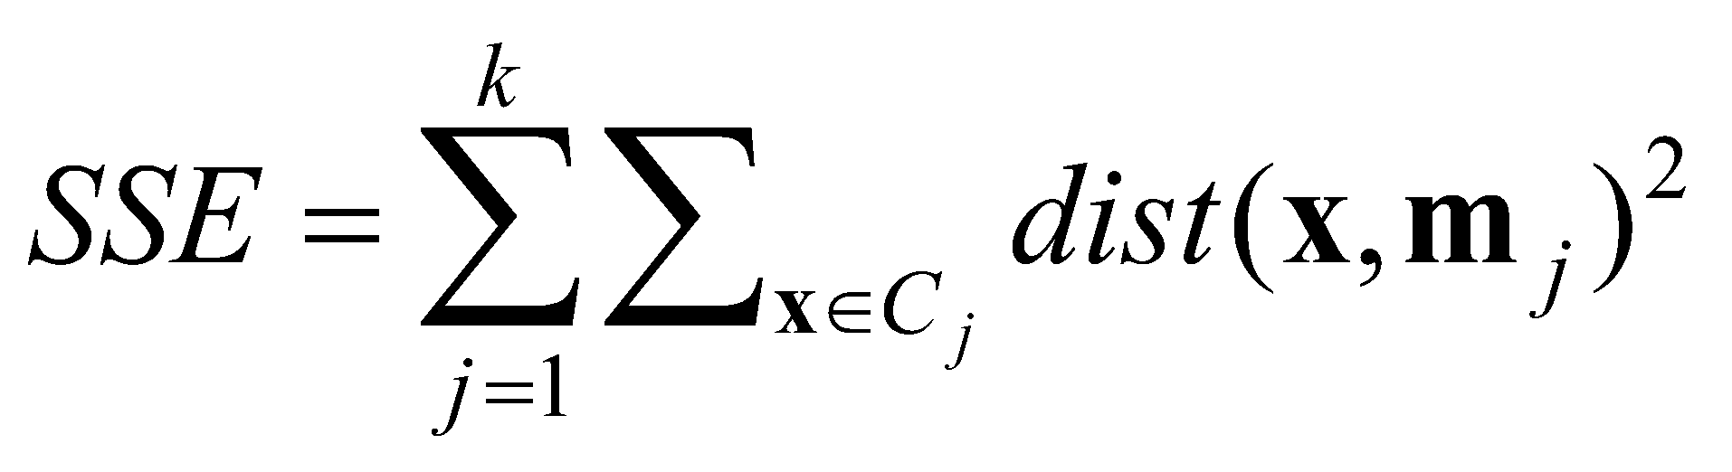
Stopping/Convergence Criterion
No (or minimum) re-assignments of data points to different clusters,
No (or minimum) change of centroids, or
Minimum decrease in the sum of squared error (SSE),
C_{i} is the j^{th} cluster, m_{j} is the centroid of cluster C_{j} (the mean vector of all the data points in C_{j}), and dist(x, m_{j}) is the distance between data point x and centroid m_{j}.

Slide 28
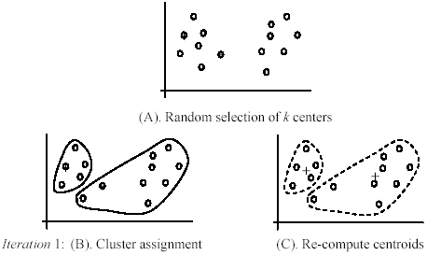
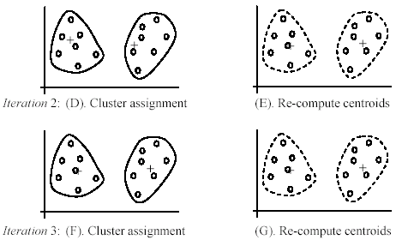
An Example of KMeans Clustering

Slide 29
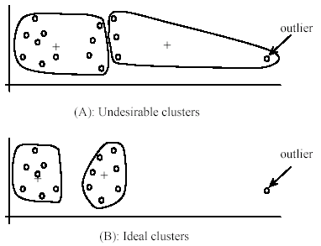
Strengths and Weakness of KMeans
Strength
Simple: easy to understand and to implement
Efficient: Time complexity: O(tkn),
where n is the number of data points,
k is the number of clusters, and
t is the number of iterations.
Since both k and t are small, k-means is considered a linear algorithm
The most popular clustering algorithm
Weakness
The user needs to specify k.
The algorithm is sensitive to outliers
Outliers are data points that are very far away from other data points.
Outliers could be errors in the data recording or some special data points with very different values.

Slide 30
Strengths and Weakness of KMeans
Weakness
Processing outliers
Remove some data points in the clustering process that are much further away from the centroids than other data points.
To be safe, we may want to monitor these possible outliers over a few iterations and then decide to remove them.
Perform random sampling.
Since in sampling we only choose a small subset of the data points, the chance of selecting an outlier is very small.
Assign the rest of the data points to the clusters by distance or similarity comparison, or classification

Slide 31
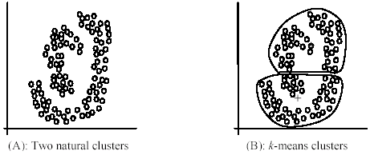
Strengths and Weakness of KMeans
Weakness
The k-means algorithm is not suitable for discovering clusters that are not hyper-ellipsoids (or hyper-spheres).

Slide 32
KMeans Summary
Despite weaknesses, k-means is still the most popular algorithm due to its simplicity, efficiency.
No clear evidence that any other clustering algorithm performs better in general
although they may be more suitable for some specific types of data or applications.
Comparing different clustering algorithms is a difficult task.
No one knows the correct clusters!

Slide 33
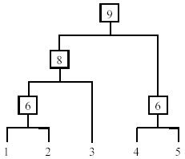
Hierarchical Clustering
Produce a nested sequence of clusters, a tree, also called Dendrogram.

Slide 34
Types of Hierarchical Clustering
Agglomerative (bottom up) clustering: It builds the tree from the bottom level, and
Merges the most similar (or nearest) pair of clusters
Stops when all the data points are merged into a single cluster (i.e., the root cluster).
Divisive (top down) clustering: It starts with all data points in one cluster, the root.
Splits the root into a set of child clusters. Each child cluster is recursively divided further
Stops when only singleton clusters of individual data points remain, i.e., each cluster with only a single point

Slide 35
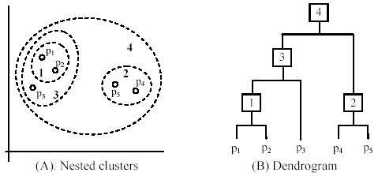
Agglomerative Clustering
It is more popular than divisive methods.
The basic ideas are below:
At the beginning, each data point forms a cluster (also called a node).
Merge nodes/clusters that have the least distance.
Go on merging
Eventually all nodes belong to one cluster

Slide 36
Hard to Evaluate Clustering Performance
The quality of a clustering is very hard to evaluate since we do not know the correct clusters
Some methods are used:
User inspection
Study centroids
For text documents, one can read some documents in clusters.

Slide 37
Gaussian Mixture Modelling (GMM)

Slide 38
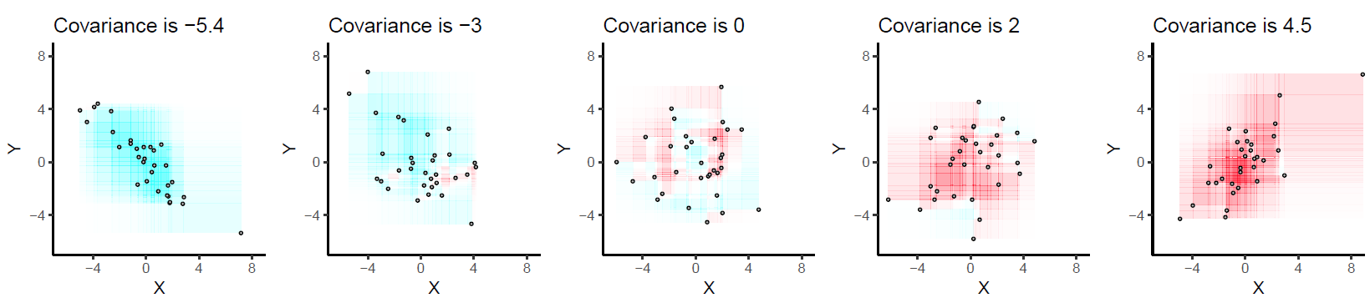
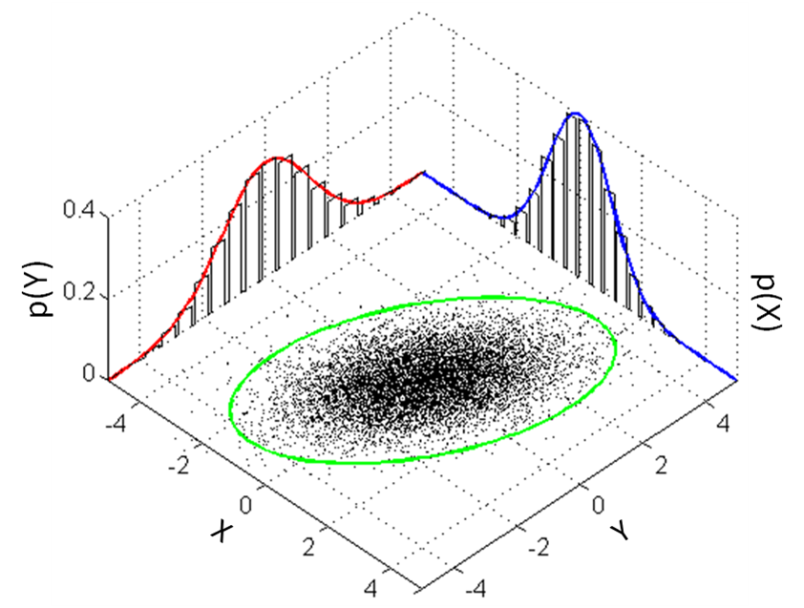
Gaussian Mixture Modelling (GMM)
For k-means, the biggest limitation is that each cluster has the same diagonal covariance matrix.
Density of the data is not considered, most of the data are distributions.
These produce spherical clusters that are quite inflexible in terms of the types of distributions they can model.

Slide 39
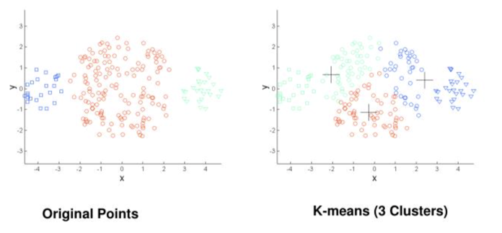
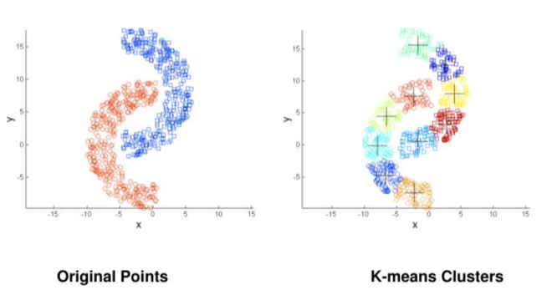
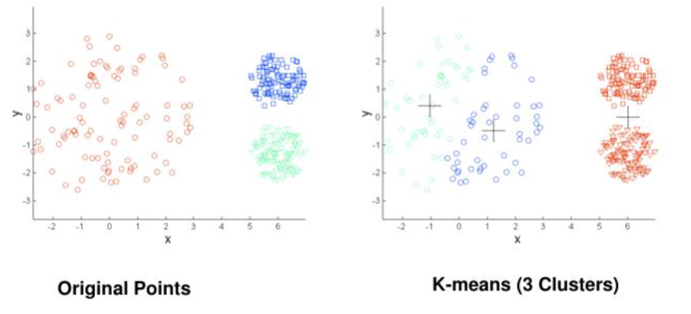
Limitation of Kmeans
Different sizes of data distribution.
Different density of data distribution.
Solution: smaller cluster. Or algo mentioned earlier.

Slide 40
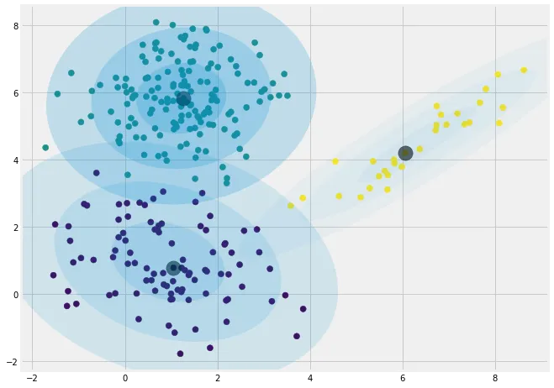
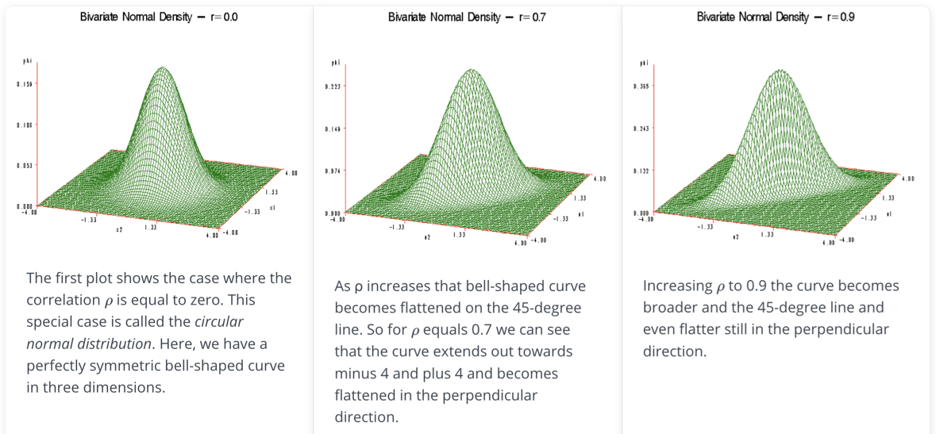
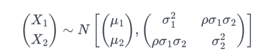
GMM made simple(ish)
At its simplest, GMM is also a type of clustering algorithm. As its name implies, each cluster is modelled according to a different Gaussian distribution.
This flexible and probabilistic approach to modelling the data means that rather than having hard assignments into clusters like k-means, we have soft assignments.
This means that each data point could have been generated by any of the distributions with a corresponding probability.
Bivariate Normal Distribution

Slide 41

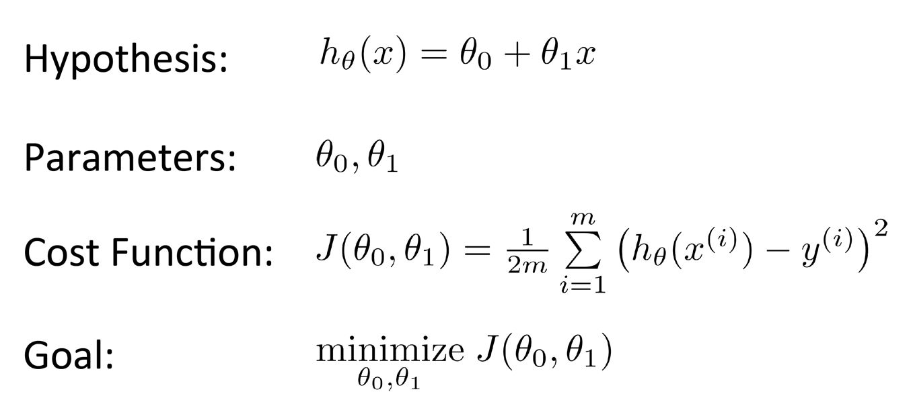
Maximum-likelihood Estimation (MLE)
We want to estimate parameter ፀ

Slide 42
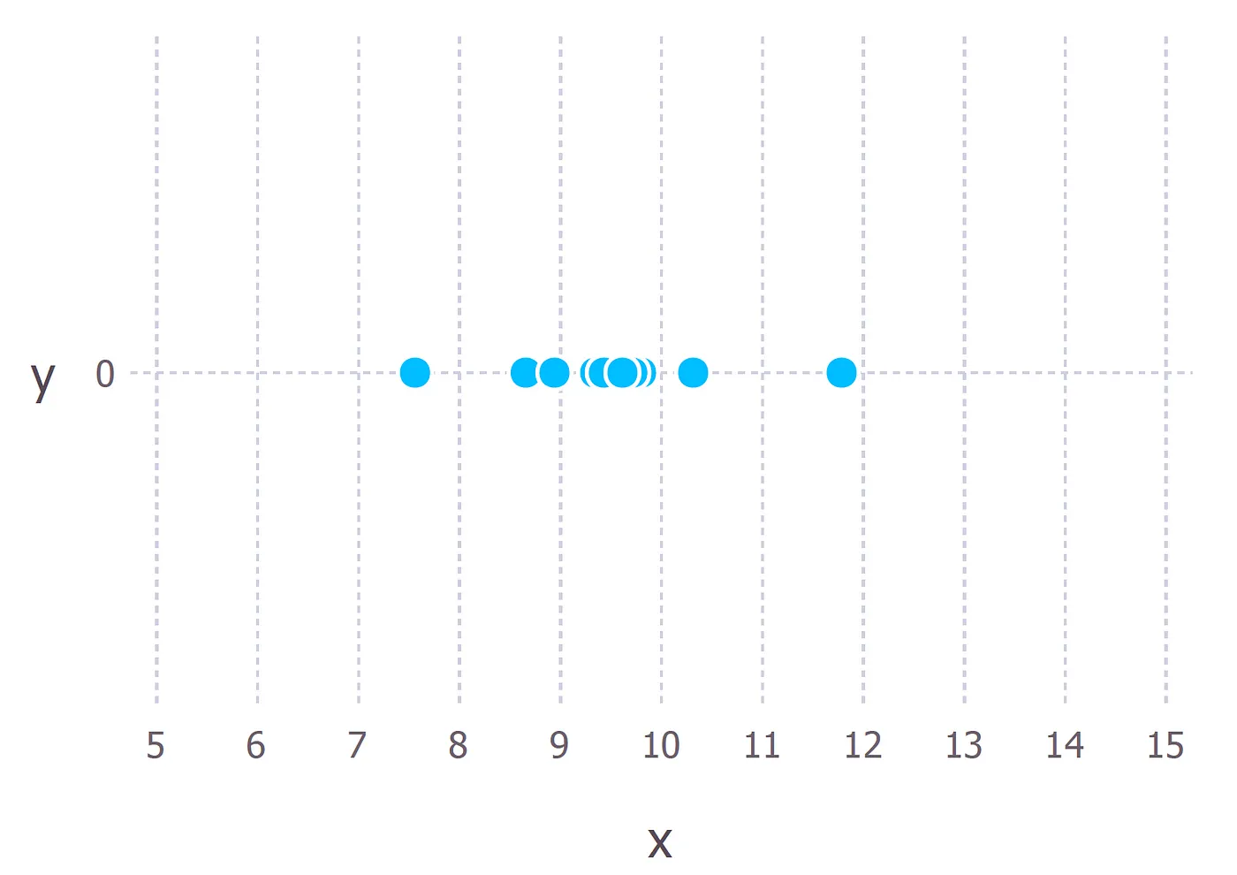
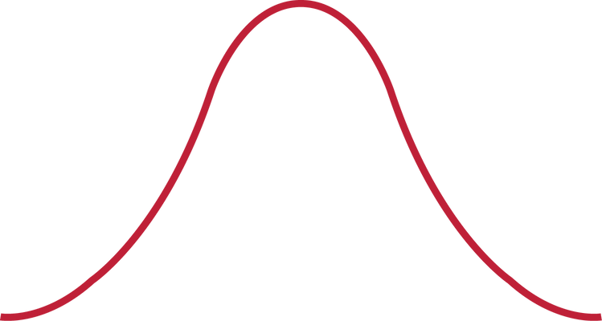
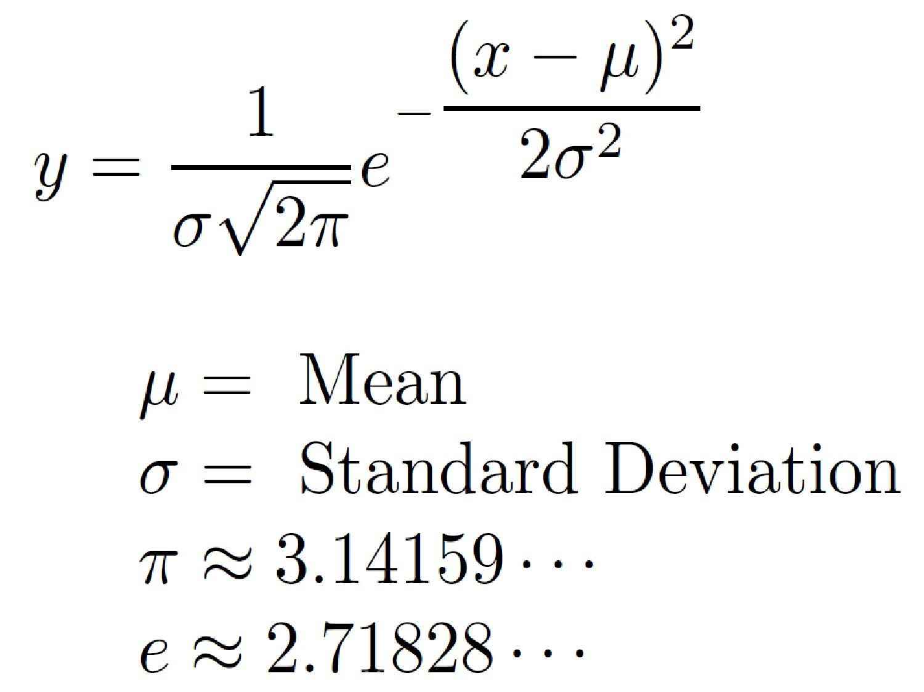
Maximum-likelihood Estimation (MLE)
Normal Distribution:

Slide 43
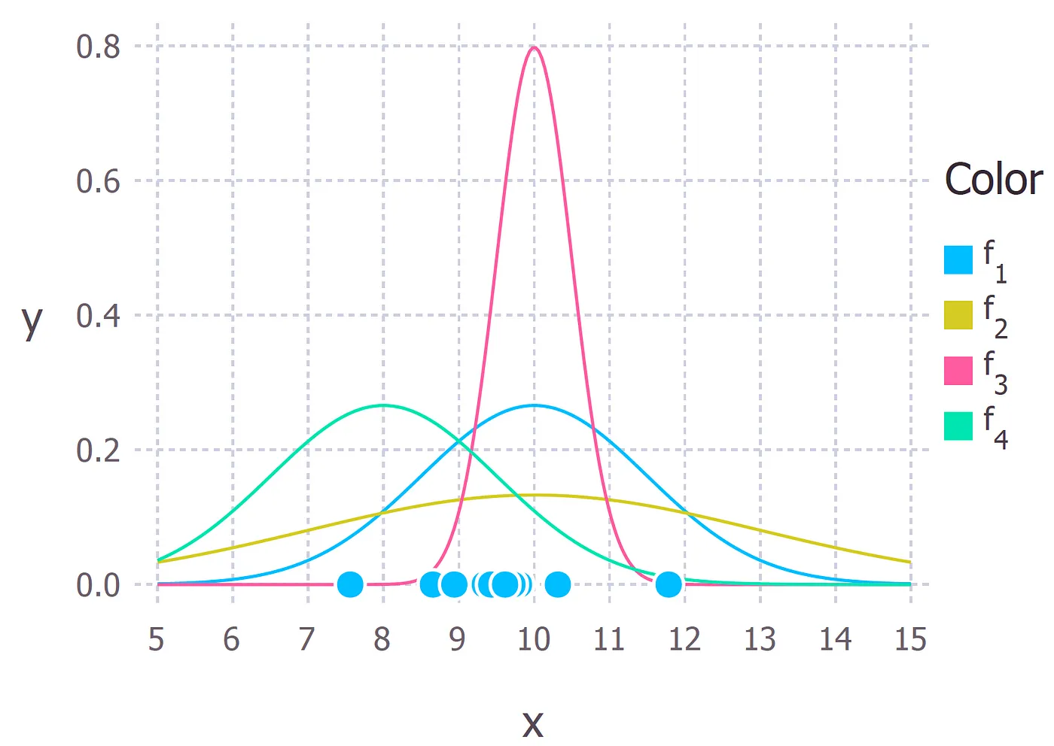
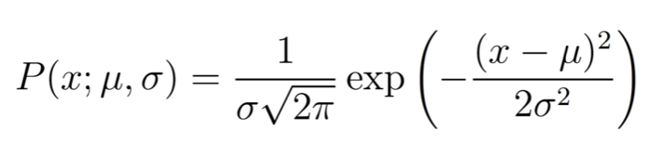
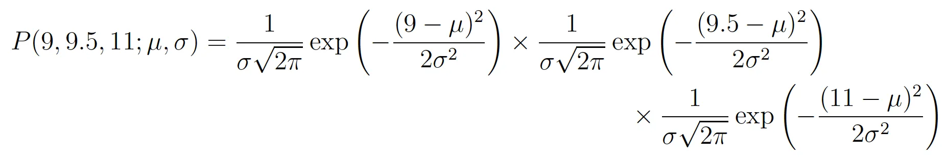
Maximum-likelihood Estimation (MLE)
Normal Distribution:
We just have to figure out the values of μ and σ that results in giving the maximum value of the above expression.
Notes:
If you’ve covered calculus in your maths classes then you’ll probably be aware that there is a technique that can help us find maxima (and minima) of functions. It’s called differentiation. All we have to do is find the derivative of the function, set the derivative function to zero and then rearrange the equation to make the parameter of interest the subject of the equation. And voilà, we’ll have our MLE values for our parameters. I’ll go through these steps now but I’ll assume that the reader knows how to perform differentiation on common functions. If you would like a more detailed explanation then just let me know in the comments.

Slide 44
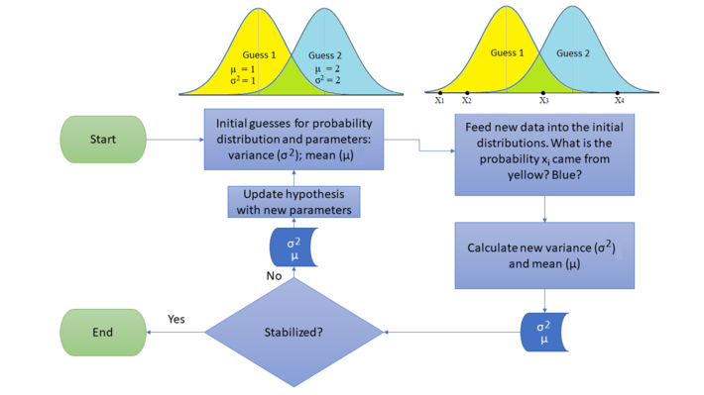
Expectation Maximisation (EM) Algorithm
How can we estimate this type of model?
The EM algorithm finds maximum-likelihood estimates for model parameters when you have incomplete data.
The “E-Step” finds probabilities for the assignment of data points, based on a set of hypothesized probability density functions;
The “M-Step” updates the original hypothesis with new data. The cycle repeats until the parameters stabilize.

Slide 45
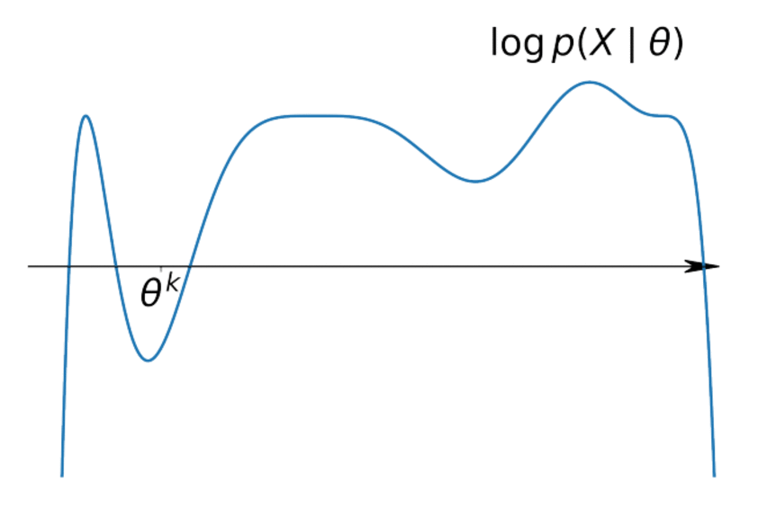
EM Algo

